Slide 1
Data Pipeline

Slide 2
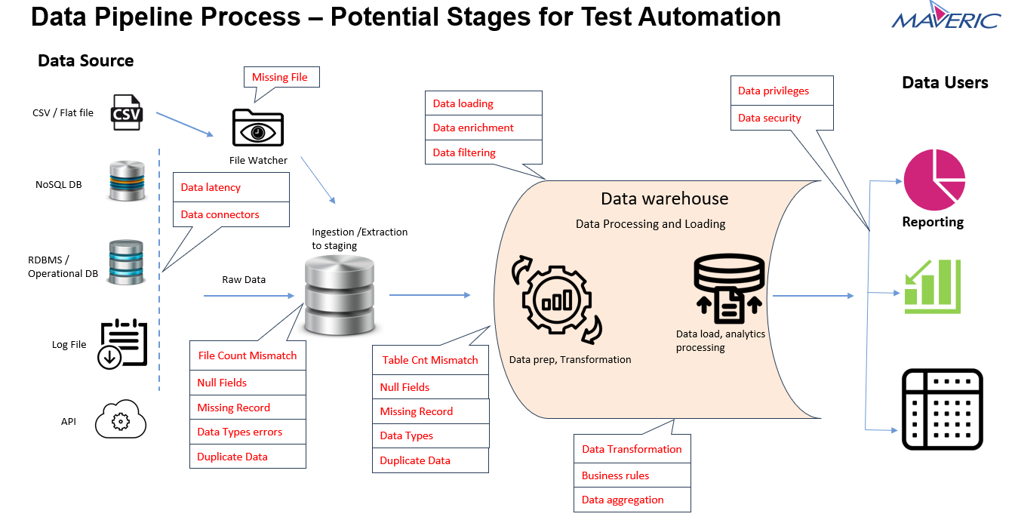
Problem Statement (As given) for Data Pipeline:
Problem Statement :
First, it takes too long and is a critical inhibitor to the frequent delivery of pipelines. Teams that rely primarily on manual testing end up postponing testing to dedicated testing periods, allowing bugs to accumulate.
Objective:
A characteristic of data pipeline development is the frequent release of high-quality data to gain user feedback and acceptance. At the end of every data pipeline iteration, it’s expected that the data is of high quality for the next phase. Automated testing is essential for the integration testing of data pipelines.
Technology Stack:
Hadoop, Spark framework with programing language python/Scala/java, Hive as data warehouse, NoSQL DB or MySQL DB.
Visual Studio Code/PyCharm/IntelliJ is used as an IDE.
GitHub is used as a version control system.
Any open-source Visualization tools.

Slide 3
Problem Statement & Solution - ML
Challenges
Raw data can be messy and contain errors or missing values.
Filtering the data manually based on business requirement it is tedious and time-consuming task.
Business requirements may change over time, requiring adjustments to data processing logic.
Creating a user-friendly and responsive interface to visualize and analyze the data can be challenging.
Solution
Develop data quality checks and data cleansing procedures to ensure that the data is accurate and complete before processing
Develop a flexible and modular codebase that allows for easy modification and addition of business logic.
Use modern frontend frameworks like Angular to create responsive and interactive charts.

Slide 4
INTRODUCTION :
Data pipeline project collects the data, process, and visualize sales data from various e-commerce sites to derive valuable insights.
We collect sales history data from e-commerce sites, ensuring a reliable data source for analysis
It takes the data in csv file from external sources.
Based on the business requirements it will filter and transform the
data and generates the reports in the form of bar charts and pie charts.
The project consists of a Java Spring Boot backend for data processing and an Angular frontend for visualization

Slide 5
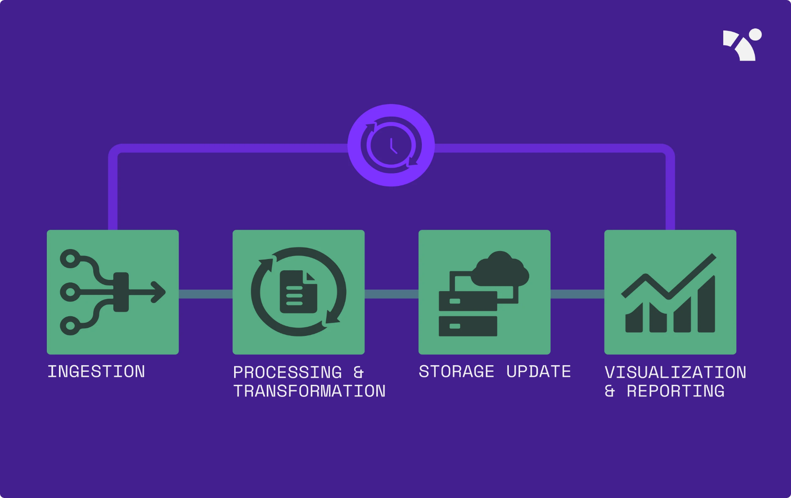
AML AIML Architecture

Slide 6




Frontend - Angular
Backend - Java, Spring Boot, Microservices
DB – MySQL
Technology Stack :

Slide 7
Project Overview :
Analyzing the sales history: In this process we Gather all available sales data, including transaction records. Organize this data in a structured format and storing it in the MySQL Database.
Data Transformation :Data transformation process that involves converting raw sales data into a structured format suitable for analysis, reporting, and visualization.
We apply business logic to aggregate, filter, and transform data based on category and product criteria.
Data Visualization : Angular-based frontend provides user-friendly interfaces with interactive charts (bar charts, pie charts) for data visualization. After the data transformation we are providing the visualization tools like bar charts, pie charts which helps us to spot trends and patterns more easily.

Slide 8
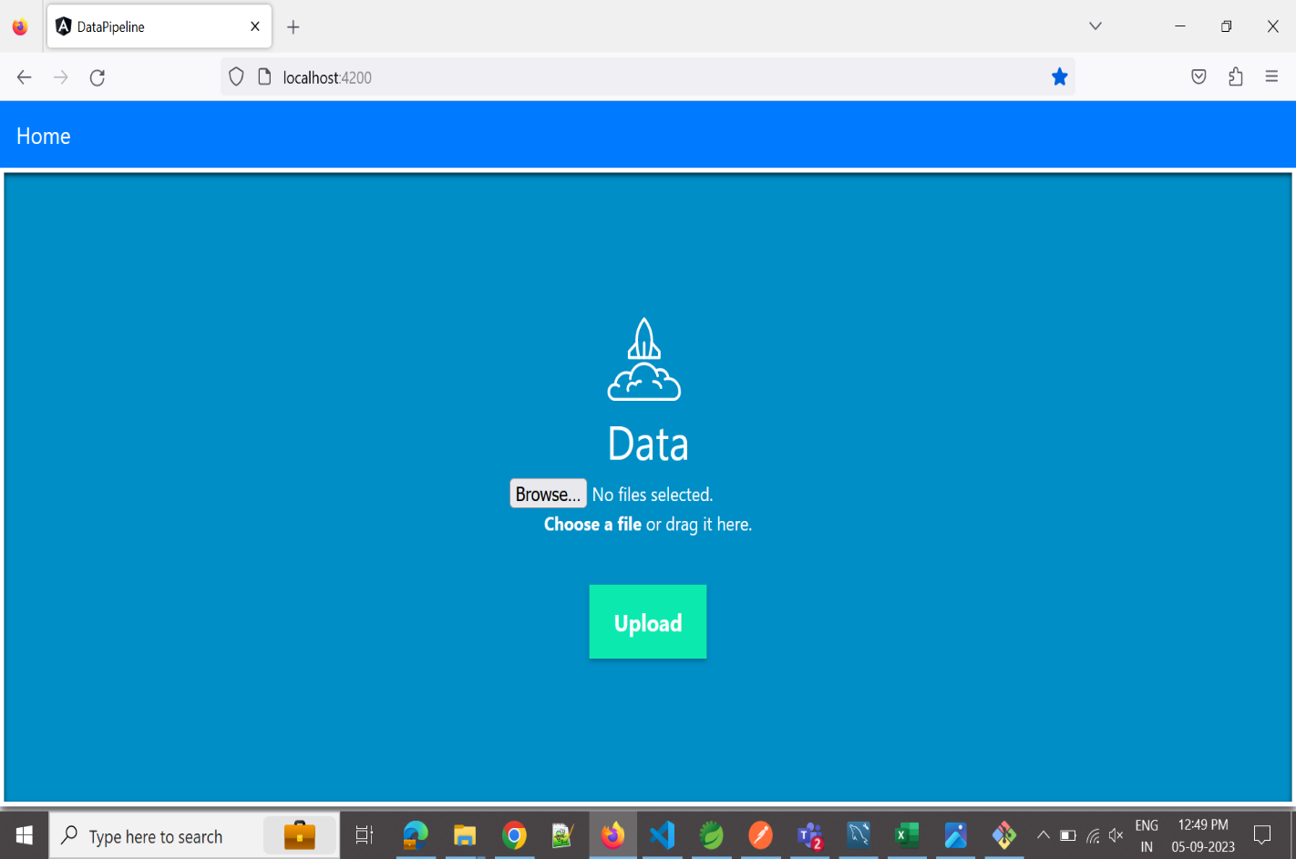
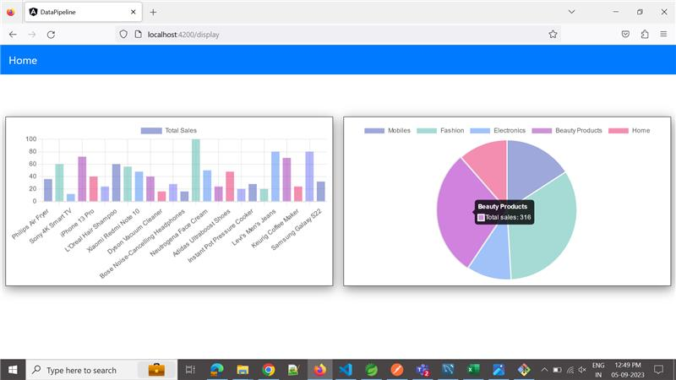
Upload CSV file
Generated Reports

Slide 9


